Slide 1

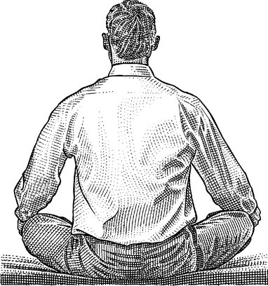

Slide 2
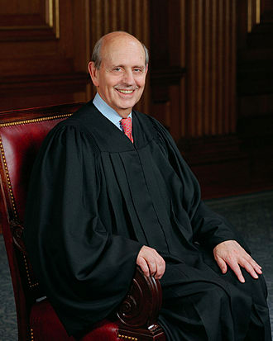
“ . . . the practice of law is like attempting to drink water from a fire hose. And if you are under stress, meditation – or whatever you choose to call it – helps. [I]in circumstances that may be considered stressful, say in oral arguments where I have to concentrate very hard for extended periods. If I . . . sit for 15 minutes, and perhaps another 15 minutes later, [I] feel more peaceful, focused and better able to do my work.” Justice Stephen Breyer

Slide 3
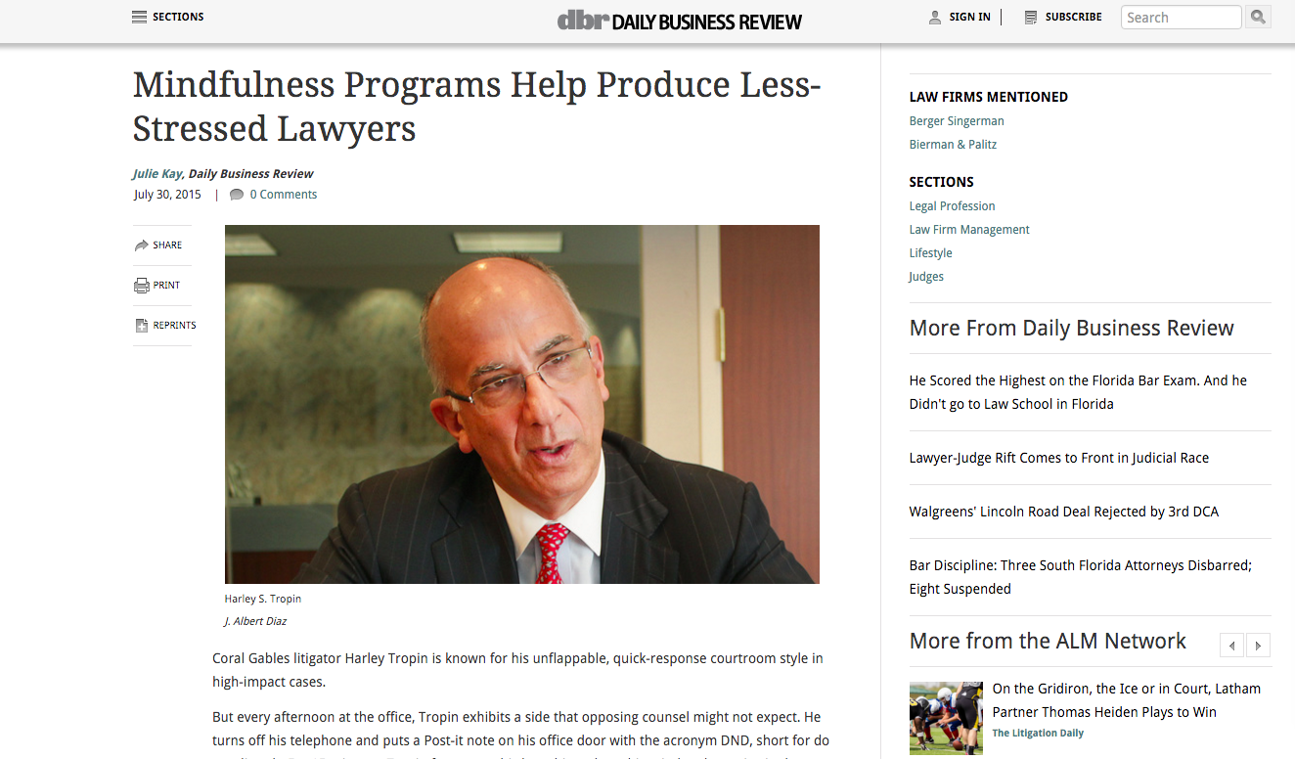

Slide 4
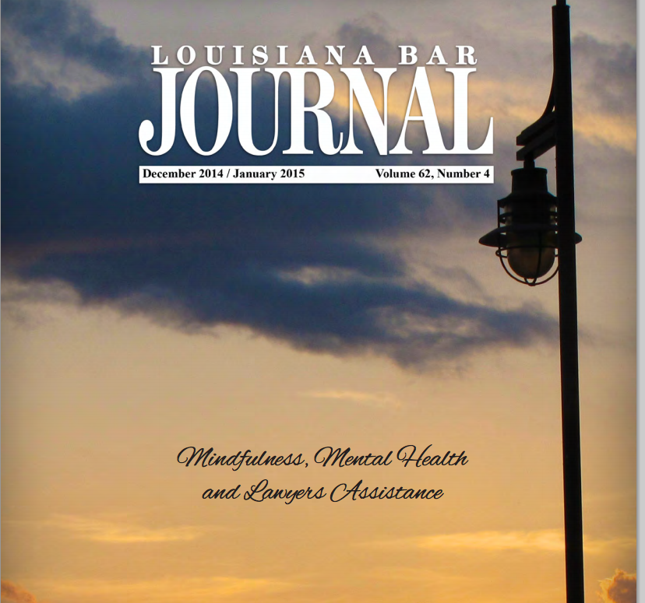

Slide 5
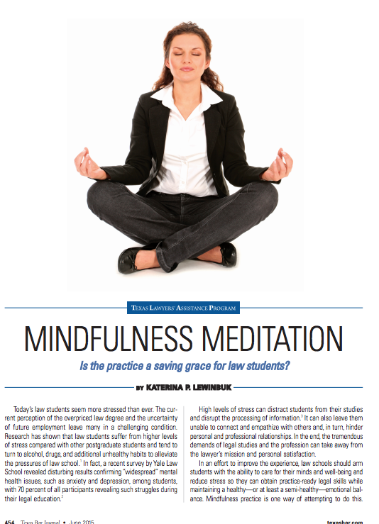

Slide 6
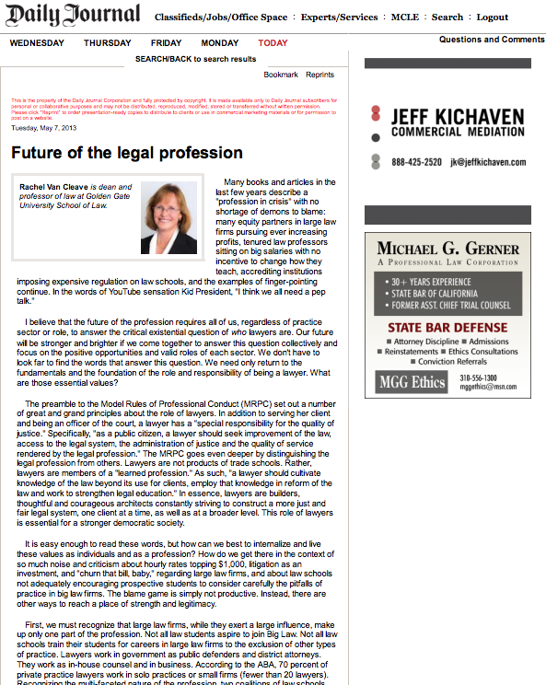

Slide 7


Slide 8













Slide 9








Slide 10














Slide 11


Slide 12
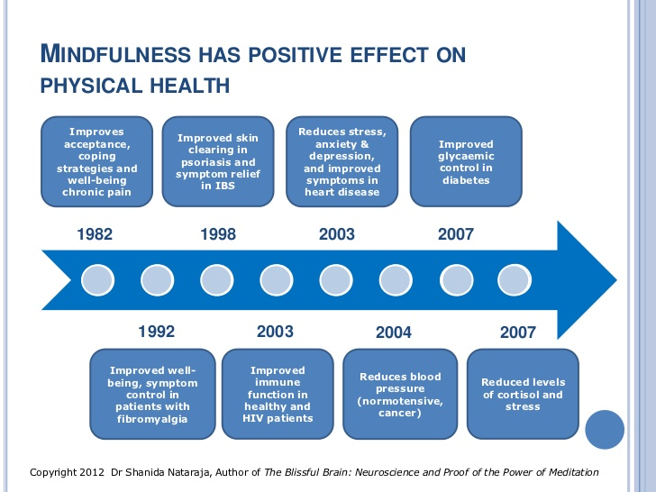

Slide 13
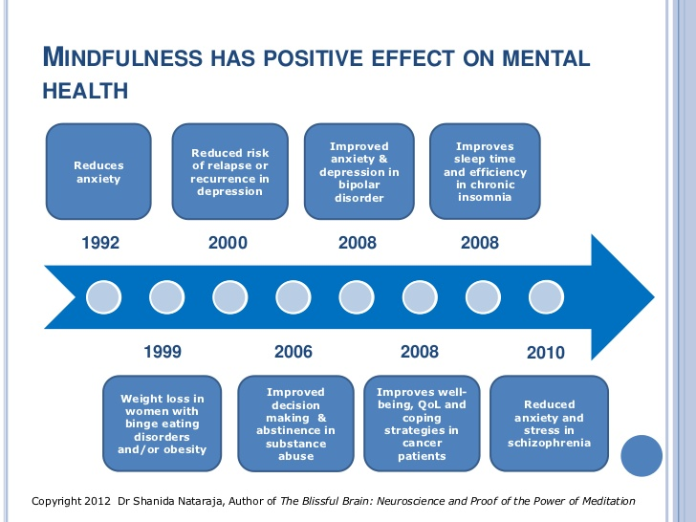

Slide 14
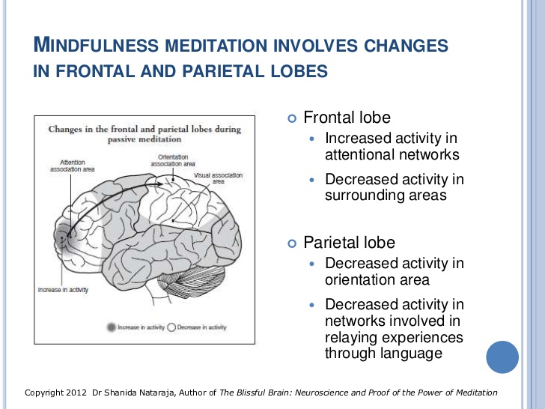

Slide 15
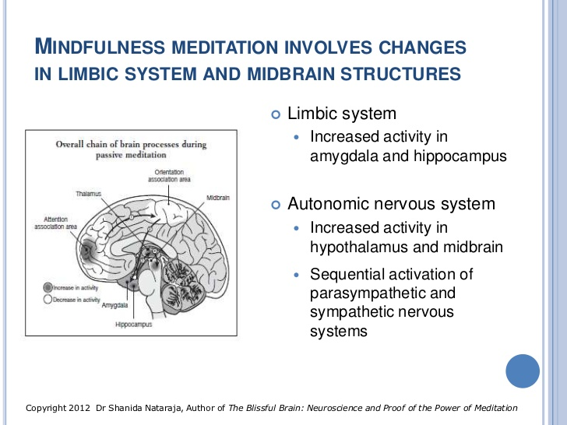

Slide 16
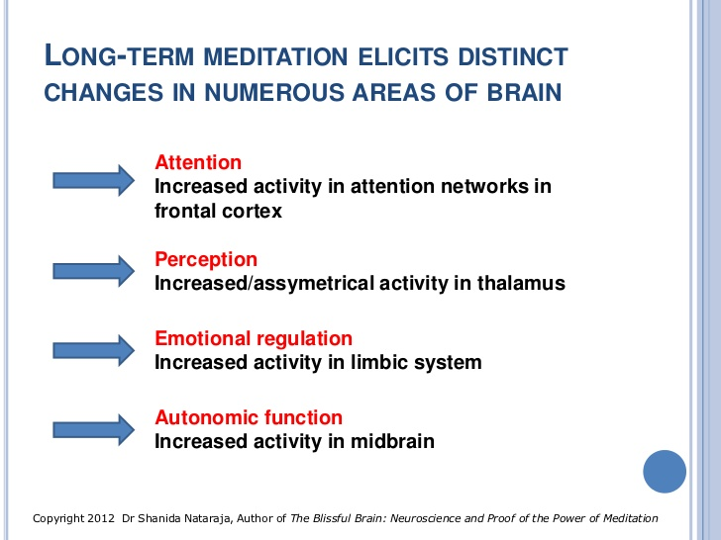

Slide 17
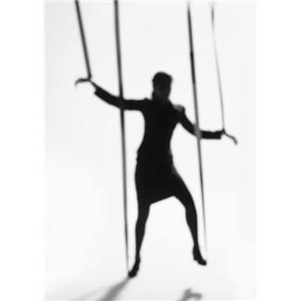
Without Mindfulness:
Stimulus
Reaction
With Mindfulness:
Stimulus
Mindfulness
Choice
Response
Notes:
Stimulus – Mindfulness- Choice – Response, vs Stimulum – Responses

